Slide 1

Sales Insights
Aditya Deshpande

Slide 2
Problem Statement
The sales team at AtliQ Hardware struggles with fragmented reporting and delayed insights due to manual data consolidation from various sources.
To address this, a Sales Insight Dashboard is needed to centralize data visualization, enable real-time updates, and provide actionable insights.
This dashboard will improve decision-making, enhance performance tracking, and streamline reporting processes. By leveraging advanced analytics and intuitive data visualizations, the sales team will be empowered to optimize strategies, increase efficiency, and drive higher revenue growth.

Slide 3
Our Aim
We aim to achieve a centralized Sales Insight Dashboard that provides real-time, accurate data visualization, enabling the sales team to make informed decisions quickly.
This dashboard will enhance performance tracking, streamline reporting processes, and offer actionable insights to optimize sales strategies.
Ultimately, the goal is to increase sales efficiency, improve sales team performance, and drive higher revenue growth.

Slide 4
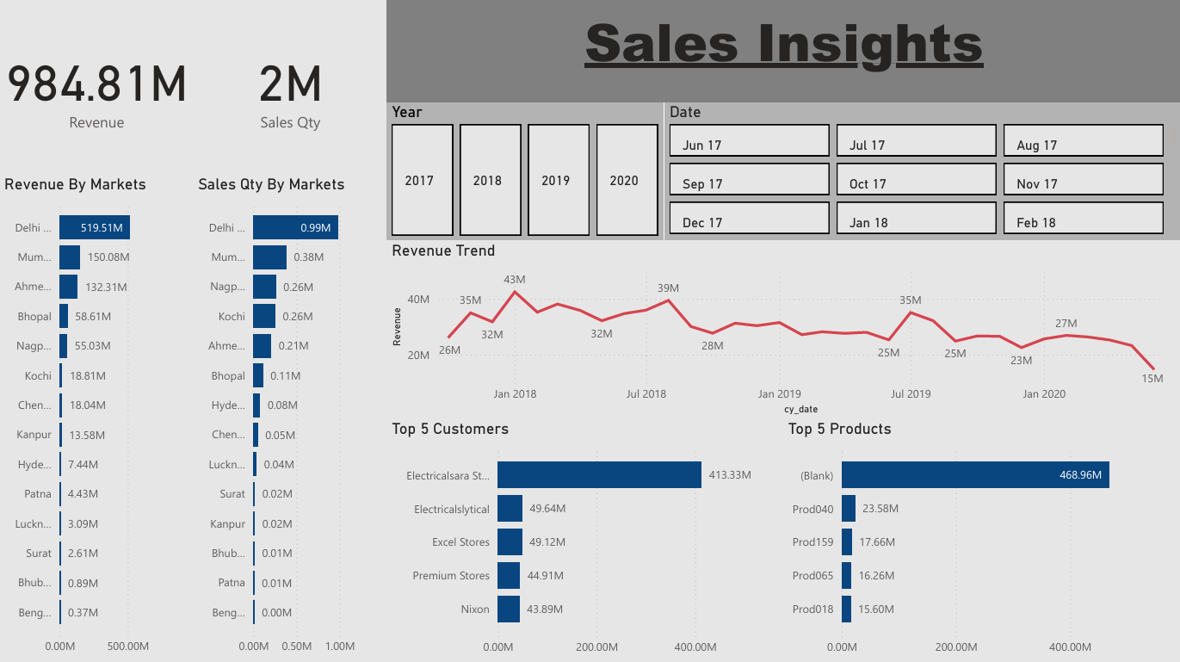
Dashboard

Slide 5
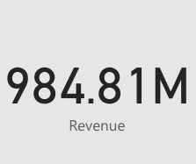
Revenue
Display the overall revenue within a specific period and for a specific product.
Includes comparison to previous periods to highlight growth or decline trends.

Slide 6
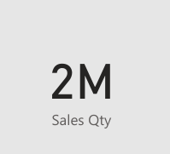
Sales Quantity
Display the overall units sold within a specific period and for a specific product.
Includes comparison to previous periods to highlight growth or decline trends.

Slide 7
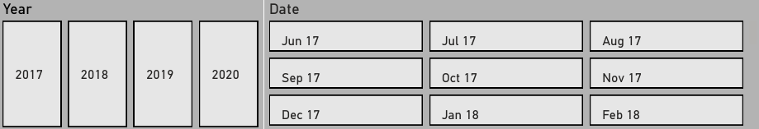
Year & Date
Display cumulative sales and revenue data within a specific date or year.
Allows to select custom date ranges for analyzing sales and revenue data.

Slide 8
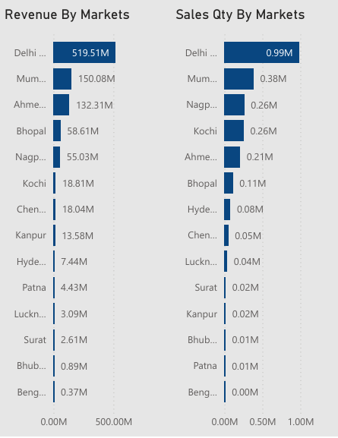
Revenue & Sales Qty By Markets

Slide 9
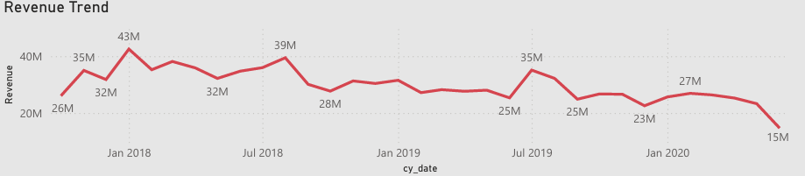
Revenue Trend
Highlight peak seasons and low periods to aid in strategic planning.

Slide 10
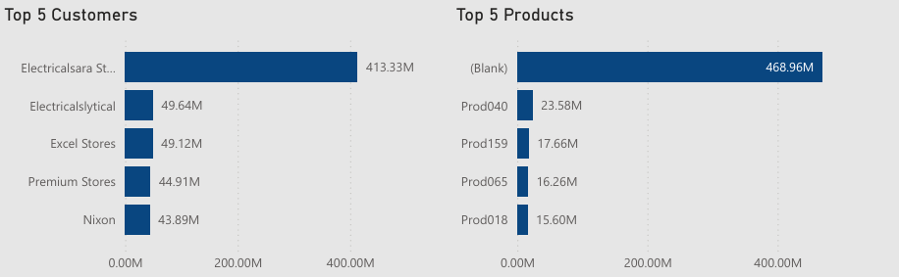
Top 5 Customers & Products
Displays the top 5 customers and the top 5 selling products.

Slide 11
Conclusion
The implementation of a Sales Insight Dashboard at AtliQ Hardware aims to revolutionize the way the sales team accesses and utilizes data.
By centralizing data visualization, enabling real-time updates, and providing actionable insights, the dashboard will empower the sales team to make informed, data-driven decisions swiftly.
Ultimately, the Sales Insight Dashboard will transform data into a strategic asset, fostering a proactive sales environment where the team can anticipate market changes, respond dynamically to challenges, and consistently achieve their sales targets.

